Slide 1
Fundamentals of Information Technology
Network Engineering Project
By James CAO
Mar. 2017

Slide 2
Network engineering project schedule
No | Contents | Hours
1 | Project 1 : Switch configuration
 | Project 1.1: Basic configuration | 2
 | Project 1.2: VALN configuration | 2
2 | Project 2 : Router configuration
 | Project 2.1: Static route configuration | 2
 | Project 2.2: Dynamic route configuration | 2
3 | Project 3 : Firewall configuration
 | Project 3.1:Basic configuration | 2
 | Project 3.2:Security rule configuration | 2

Slide 3
Project 3 : Firewall configuration
Notes:
within

Slide 4
Project Objectives:
Upon completion of this project, you will be able to:
Understand the concepts about firewall .
Know how to connect and install the firewall devices.
Know how to configure the firewall.

Slide 5
Contents:
1. Connecting to firewall
2. Basic configuration
3. Security policy configuration
—Packet filter configuration
—NAT configuration

Slide 6
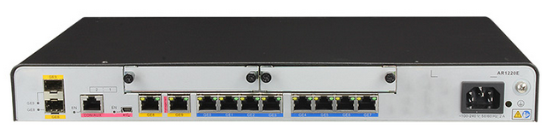
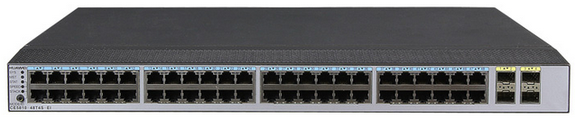
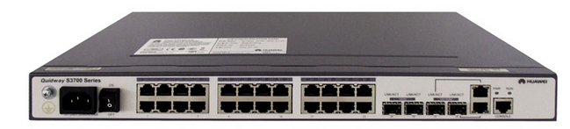

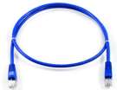

Project Design:
AR12-20 * 3
HUAWEI Switch * 4
USG6300
AR12-20 * 3
HUAWEI Switch * 4
USG6300
network cable
network cable
Team 1
Team 2
AR12-20 * 3
HUAWEI Switch * 4
USG6300
AR12-20 * 3
HUAWEI Switch * 4
USG6300
network cable
network cable
Team 3
Team 4

Slide 7
Contents:
1. Connecting to firewall
2. Basic configuration
3. Policy configuration
—Packet filter configuration
—NAT configuration

Slide 8
Project 3.1: Basic configuration of Firewall
1 console
port
1 MGM port
USG6300
2 *
10 GE SFP+
8 *
1 GE RJ45
4 *
1 GE RJ45
Firewall
LOGO

Slide 9

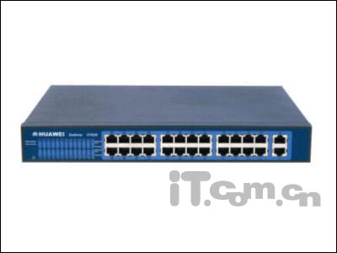
Project 3.1: Basic configuration of Firewall
In the following networking diagram, LAN A connects to Internet through GE1/0/24 of switch A and GE 1/0/0 of firewall.
Firewall(USG6300)
router 1
DMZ
GE 1/0/1
192.168.50.1
GE 1/0/5
202.100.100.1
GE 0/0/0
202.100.100.254
GE 1/0/0
192.168.30.1
PC7
GE 0/0/7
192.168.40.254/24
LAN A
GE
1/0/24
Switch A
VLAN 30
192.168.30.254/24
GE1/0/1~
GE1/0/4
GE1/0/5~GE1/0/6
Internet
PC8
PC1 PC2 PC3 PC4
PC5 PC6
192.168.40.0/24
VLAN 10
192.168.10.0/24
VLAN 20
192.168.20.0/24

Slide 10
Project 3.1: Basic configuration of Firewall
Project Goals:
1. All computers in LAN A (include sub-network VLAN 10,VLAN 20) can access PC7（in DMZ）
2. All computers in LAN A (include sub-network VLAN 10,VLAN 20) can access PC8（in Internet）
PC 8 can access PC7 WEB service（in DMZ）
PC 8 can not access LAN A
Allow
FW
Internet
DMZ
Allow
Deny
LAN

Slide 11
Project 3.1: Basic configuration of Firewall
1. To connect and access the firewall with web browser:
To connect the PC1 to MGM port at firewall USG6300, and then configure the IP address of PC1 as 192.168.0.100
Access the firewall with the web browser:
https://192.168.0.1:8443
Notice: The default IP address of MGM port is 192.168.0.1,
So if the PC1 need communicate to firewall thought MGM, the IP address must be 192.168.0.2~254

Slide 12
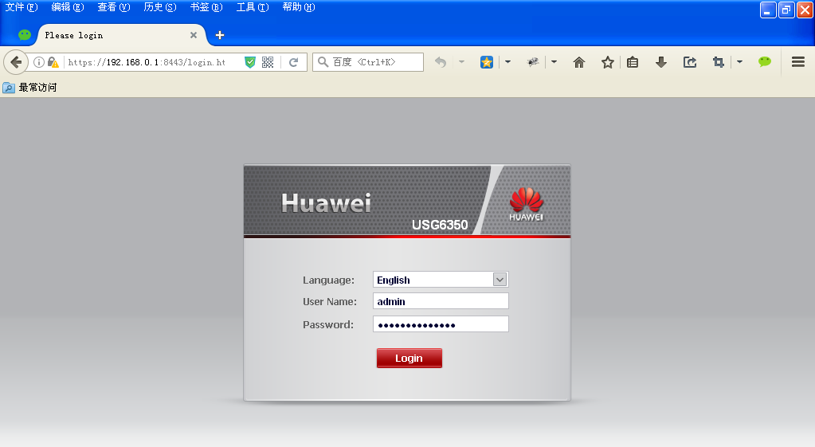
Project 3.1: Basic configuration of Firewall
The default user name and password is :
UserName: admin
Password: Admin@123
Notes:
The new password: nudt+gfkd2008

Slide 13
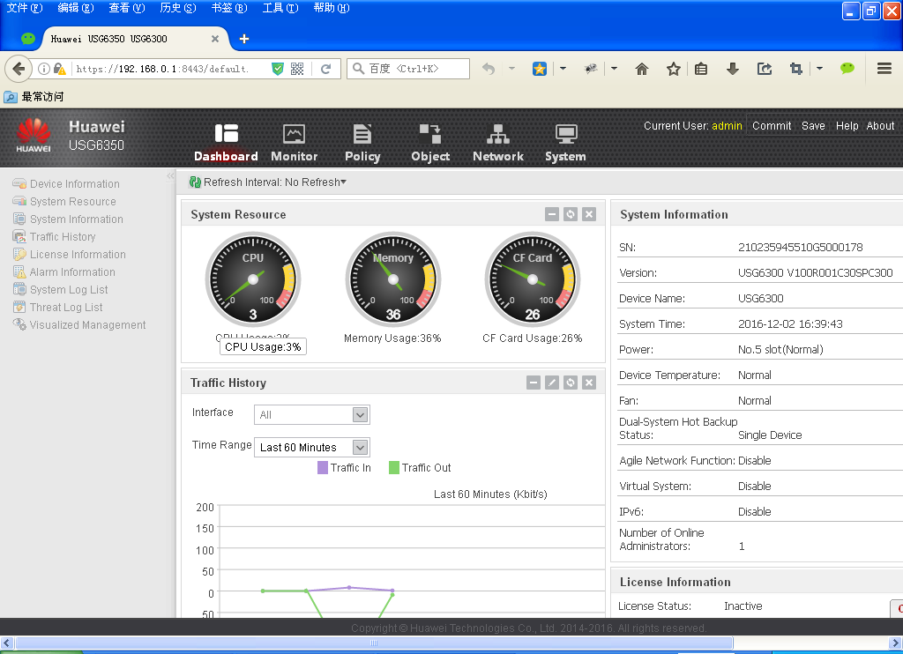
Project 3.1: Basic configuration of Firewall
The main UI (default at the dashboard menu)

Slide 14
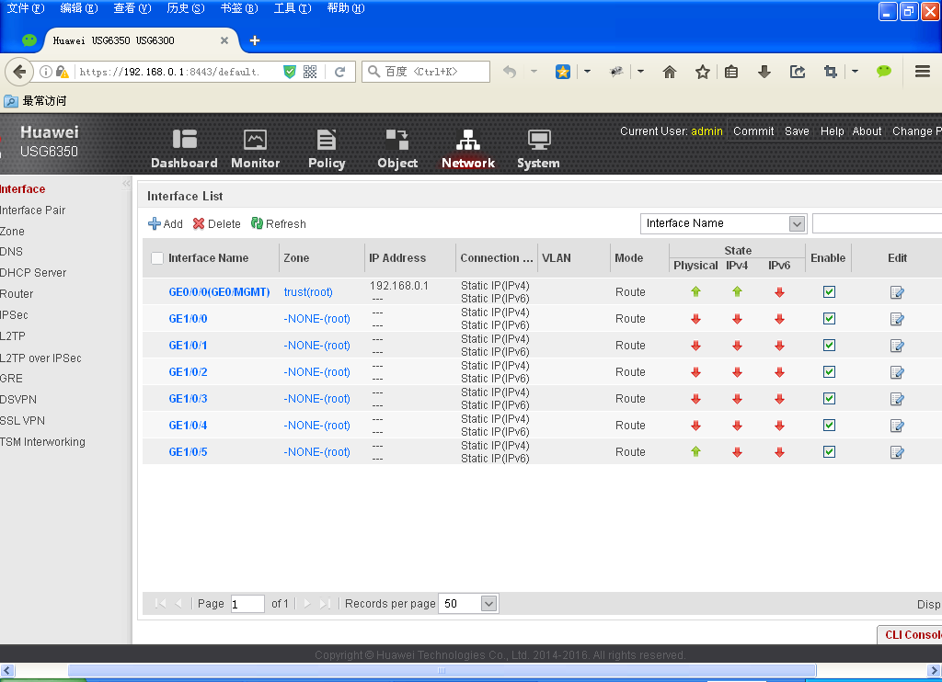
Project 3.1: Basic configuration of Firewall
2. To configure the network parameter for the firewall:

Slide 15
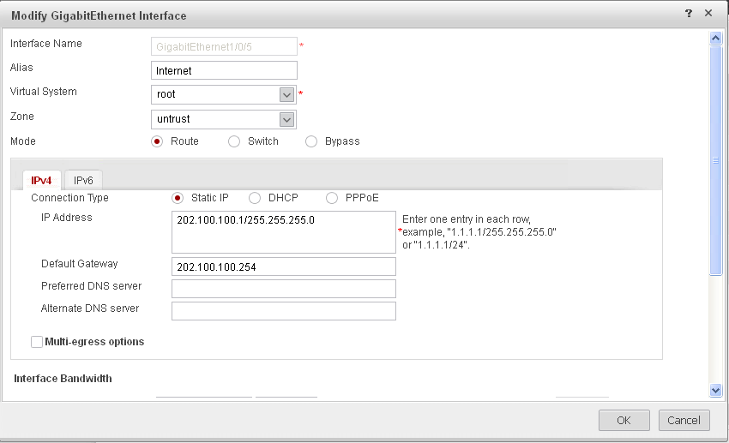
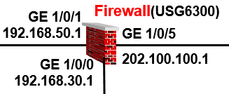
Project 3.1: Basic configuration of Firewall
To modify the parameters for Internet interface :

Slide 16
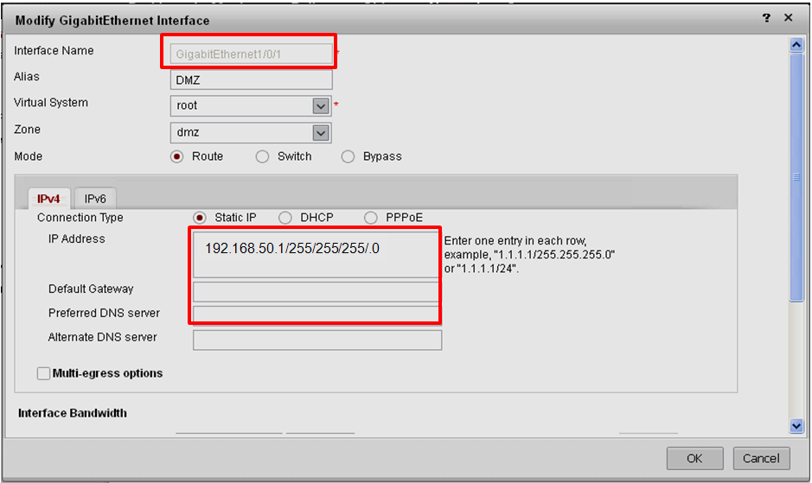
Project 3.1: Basic configuration of Firewall
To modify the parameters for DMZ interface :

Slide 17
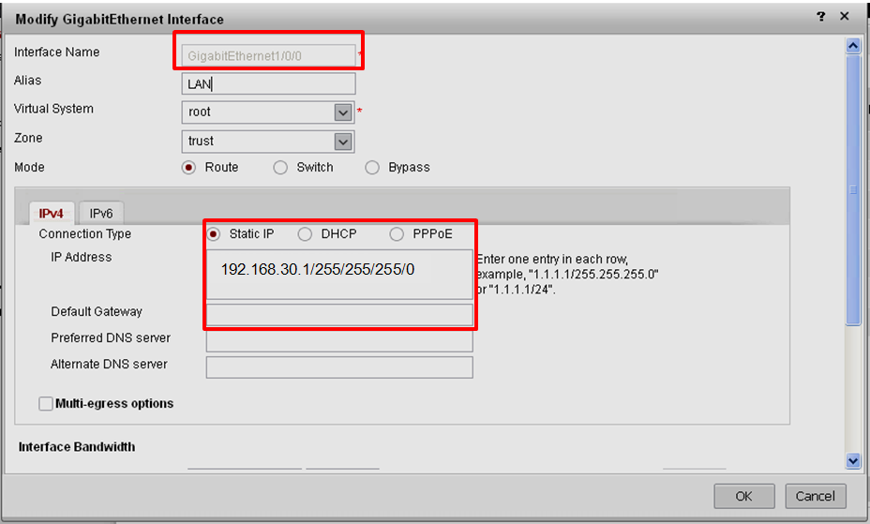
Project 3.1: Basic configuration of Firewall
To modify the parameters for LAN interface :

Slide 18
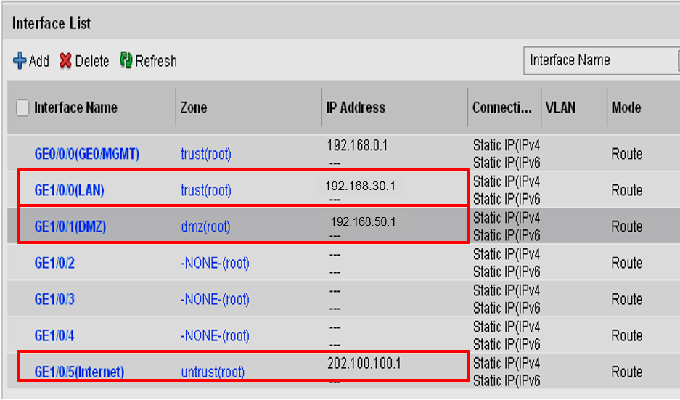
Project 3.1: Basic configuration of Firewall
The interface list :

Slide 19
Project 3.1: Basic configuration of Firewall
In the following networking diagram, LAN A connects to Internet through GE1/0/24 of switch A and GE 1/0/0 of firewall.
Firewall(USG6300)
router 1
DMZ
GE 1/0/1
192.168.50.1
GE 1/0/5
202.100.100.1
GE 0/0/0
202.100.100.254
GE 1/0/0
192.168.30.1
PC7
GE 0/0/7
192.168.40.254/24
LAN A
GE
1/0/24
Switch A
VLAN 30
192.168.30.254/24
GE1/0/1~
GE1/0/4
GE1/0/5~GE1/0/6
Internet
PC8
PC1 PC2 PC3 PC4
PC5 PC6
192.168.40.0/24
VLAN 10
192.168.10.0/24
VLAN 20
192.168.20.0/24

Slide 20
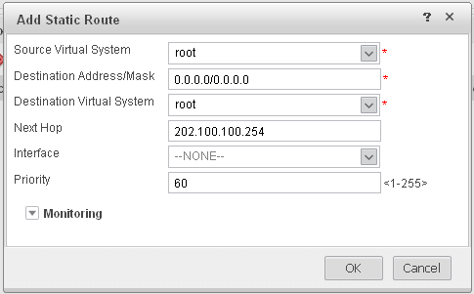
Project 3.1: Basic configuration of Firewall
3. To configure the route policy for the firewall:
To add default route for the firewall to Wide Area Network(WAN):
Default
network
Route
To Internet

Slide 21
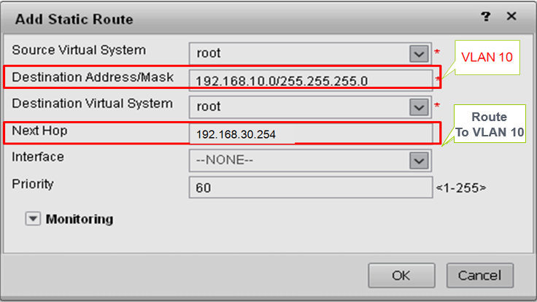
Project 3.1: Basic configuration of Firewall
To add static route for the firewall to Local Area Network( VLAN 10):

Slide 22
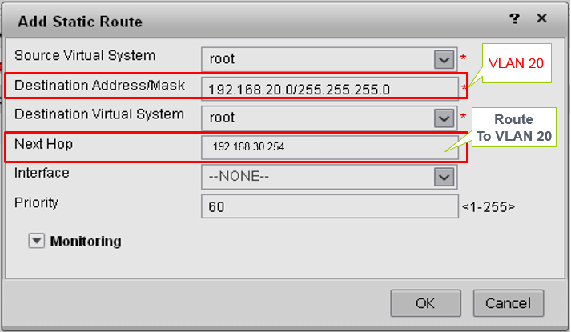
Project 3.1: Basic configuration of Firewall
To add static route for the firewall to Local Area Network( VLAN 20):

Slide 23
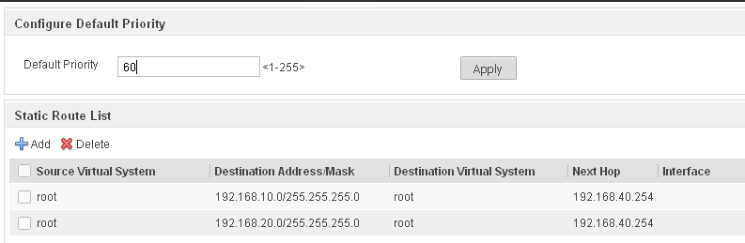
Project 3.1: Basic configuration of Firewall
The static route list for the firewall to Local Area Network:
192.168.30.254
192.168.30.254
Route
To VLAN 10,20

Slide 24
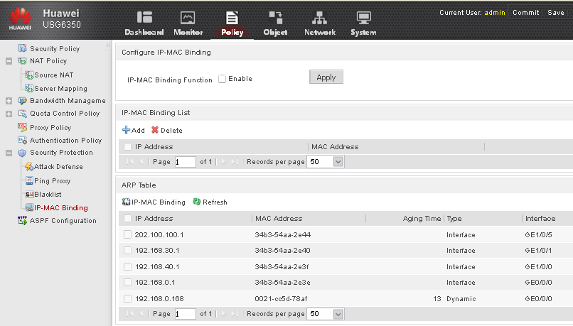
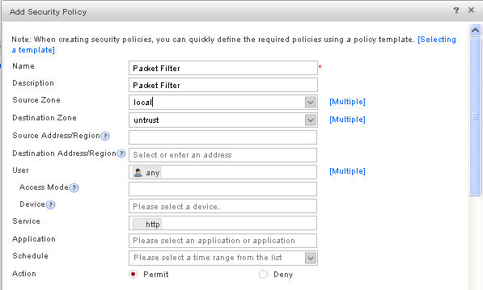
Project 3.2: Policy configuration of firewall
4. To configure the Packet Filter policy
To configure the Packet Filter policy for LAN to WAN:
From LAN
To Internet
Users
Action
HTTP
Protocol

Slide 25
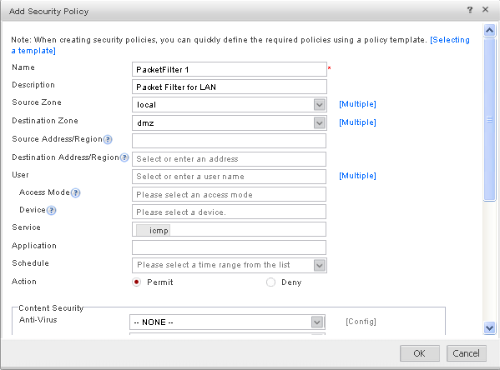
Project 3.2: Policy configuration of firewall
To configure the Packet Filter policy for LAN to DMZ:
From LAN
To DMZ
Action
ICMP
Protocol

Slide 26
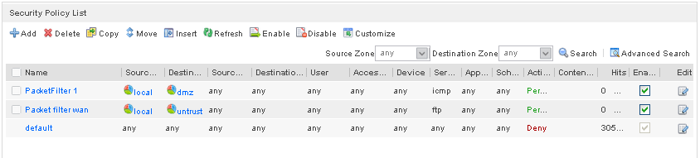
Project 3.2: Policy configuration of firewall
The Packet Filter policy list:

Slide 27
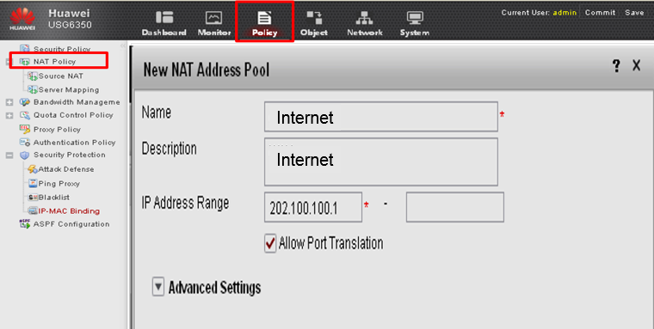
Project 3.2: Policy configuration of firewall
4. To configure the NAT Policy
To configure the NAT Address pool

Slide 28
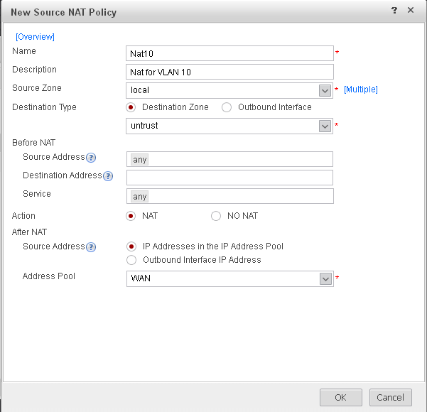
Project 3.2: Policy configuration of firewall
To configure the source NAT Policy for VLAN 10
From VLAN10
To Internet
The source IP will be translate to
202.100.100.1

Slide 29
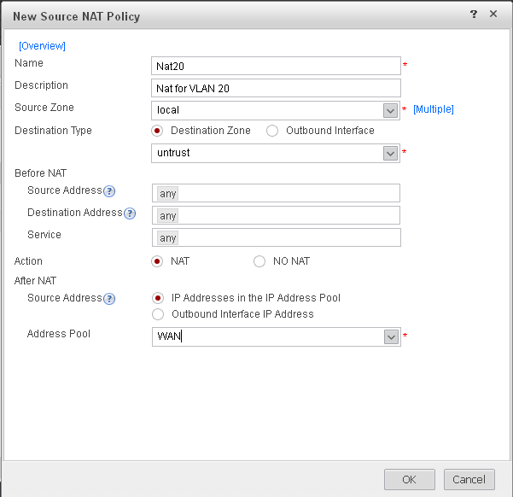
Project 3.2: Policy configuration of firewall
To configure the source NAT Policy for VLAN 10
From VLAN 20
To WAN
The source IP will be translate to
202.100.100.1

Slide 30
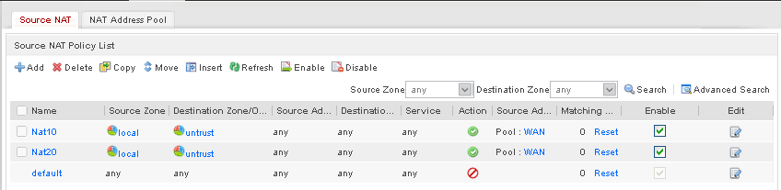
Project 3.2: Policy configuration of firewall
The source NAT Policy list:

Slide 31
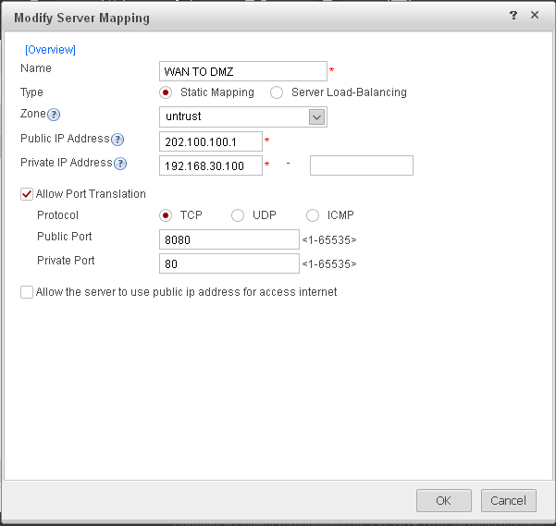
Project 3.2: Policy configuration of firewall
4. To configure the service mapping Policy
To configure the service mapping for server 192.168.30.100
Well know
server IP
LAN server IP
Well know
service port
Private
service port

Slide 32
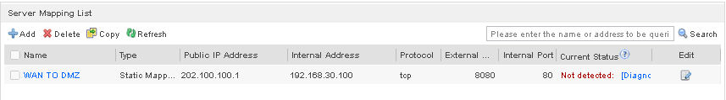
Project 3.2: Policy configuration of firewall
The service mapping list:

Slide 33
Project 3.3: Static route configuration(In layer 3 switch)
Step1: Enter system-view:
<HUAWEI> system-view
Step2: Create VLAN 10:
[HUAWEI] vlan 10
Step3: Assign the interfaces GE 1/0/1 ~
GE 1/0/4 to the VLAN 10:
[HUAWEI-vlan10]port GigabitEthernet 1/0/1
[HUAWEI-vlan10]port GigabitEthernet 1/0/2
[HUAWEI-vlan10]port GigabitEthernet 1/0/3
[HUAWEI-vlan10]port GigabitEthernet 1/0/4
[HUAWEI-vlan10]quit
Step4: Assign IP to VLAN 10:
[*HUAWEI]interface vlan 10
[*HUAWEI-Vlanif10] ip address 192.168.10.254 255.255.255.0
[*HUAWEI-Vlanif10]quit
[*HUAWEI]commit
Switch A
(HUAWEI CE58-55)
GE1/0/1~
GE1/0/4
PC1 PC2 PC3 PC4
VLAN 10
192.168.10.254 /24

Slide 34
Project 3.3: Static route configuration(In layer 3 switch)
Step5: Create VLAN 20:
[HUAWEI] vlan 20
Step6: Assign the interfaces GE 1/0/5
GE 1/0/7 to the VLAN 20:
[HUAWEI-vlan20]port GigabitEthernet 1/0/5
[HUAWEI-vlan20]port GigabitEthernet 1/0/6
[HUAWEI-vlan20]quit
Step7: Assign IP to VLAN 20:
[*HUAWEI]interface vlan 20
[*HUAWEI-Vlanif20] ip address 192.168.20.254 255.255.255.0
[*HUAWEI-Vlanif20]quit
[*HUAWEI]commit
Switch A
(HUAWEI CE58-55)
GE1/0/5~
GE1/0/7
PC5 PC6
VLAN 20
192.168.20.254 /24

Slide 35
Project 3.3: Static route configuration(In layer 3 switch)
Switch A
(HUAWEI CE58-55)
Step8: Create VLAN 30:
[HUAWEI] vlan 30
Step9: Assign the interfaces GE 1/0/24 to the VLAN 30:
[HUAWEI-vlan30]port GigabitEthernet 1/0/24
[HUAWEI-vlan30]quit
Step10: Assign IP to VLAN 30:
[*HUAWEI]interface vlan 30
[*HUAWEI-Vlanif30] ip address 192.168.30.254 255.255.255.0
[*HUAWEI-Vlanif30]quit
[*HUAWEI]commit
GE 1/0/24
VLAN 30
192.168.30.254/24

Slide 36
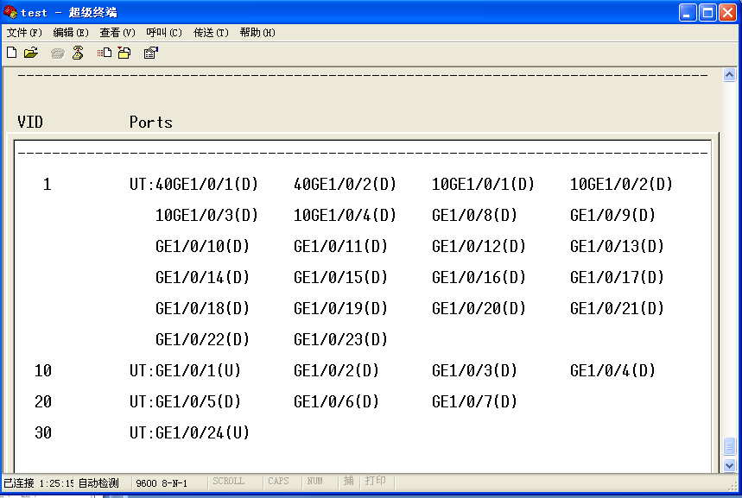
Project 3.3: Static route configuration(In layer 3 switch)
[~HUAWEI] display vlan

Slide 37
Project 3.3: Static route configuration(In layer 3 switch)
Step11: Configure the static route for layer 3 switch:
[~HUAWEI] ip route-static 0.0.0.0 0.0.0.0 192.168.30.1
[~HUAWEI]commit
Step12: Display routing table:
[*HUAWEI]display ip routing-table

Slide 38
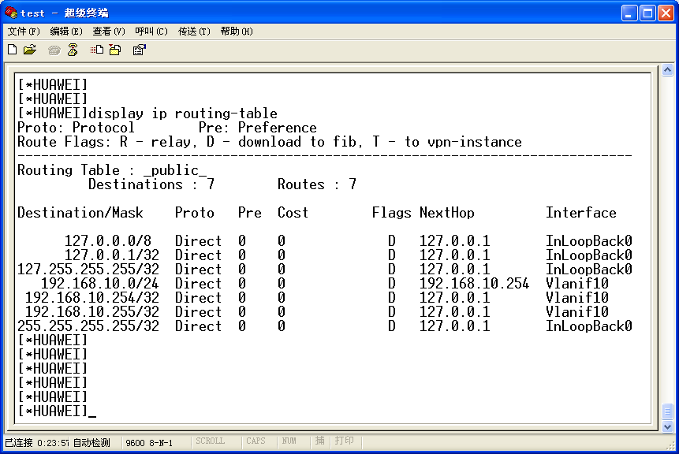
Project 3.3: Static route configuration(In layer 3 switch)
[*HUAWEI]display ip routing-table

Slide 39
Project 3.3: Static route configuration(In AR1220E-S)
router 1
(AR1220E-S)
In the Router AR1220E-S:
Step1: Enter system-view:
<Huawei>system-view
Step2: Change the interface link-type to access:
[Huawei]interface GigabitEthernet 0/0/0
[Huawei-GigabitEthernet0/0/0]port link-type access
[Huawei-GigabitEthernet0/0/0]quit
Step3: Create VLAN 60& Assign the interfaces:
[Huawei]vlan 60
[Huawei-vlan30]port GigabitEthernet 0/0/0
[Huawei-vlan30] quit
Step4:Assign IP address to VLAN 60:
[Huawei]interface vlan 60
[Huawei-Vlanif30]ip address 202.100.100.254 255.255.255.0
GE 0/0/0
VLAN 60:202.100.100.254/24
GE 0/0/7
PC8

Slide 40
Project 3.3: Static route configuration(In AR1220E-S)
Step5:Change the interface link-type to access:
[Huawei-GigabitEthernet0/0/7]interface GigabitEthernet 0/0/7
[Huawei-GigabitEthernet0/0/7]port link-type access
Step6: Create VLAN 40:
[Huawei]vlan 40
[Huawei-vlan40]port GigabitEthernet 0/0/7
[Huawei-Vlanif40]quit
Step7:Assign IP address to VLAN 40:
[Huawei-Vlanif40]interface vlan 40
[Huawei-Vlanif40]ip address 192.168.40.254 255.255.255.0
[Huawei-Vlanif40]quit
router 1
(HUAWEI AR1220E-S)
GE 0/0/0
GE 0/0/7
VLAN 40:
192.168.40.254/24
PC8

Slide 41
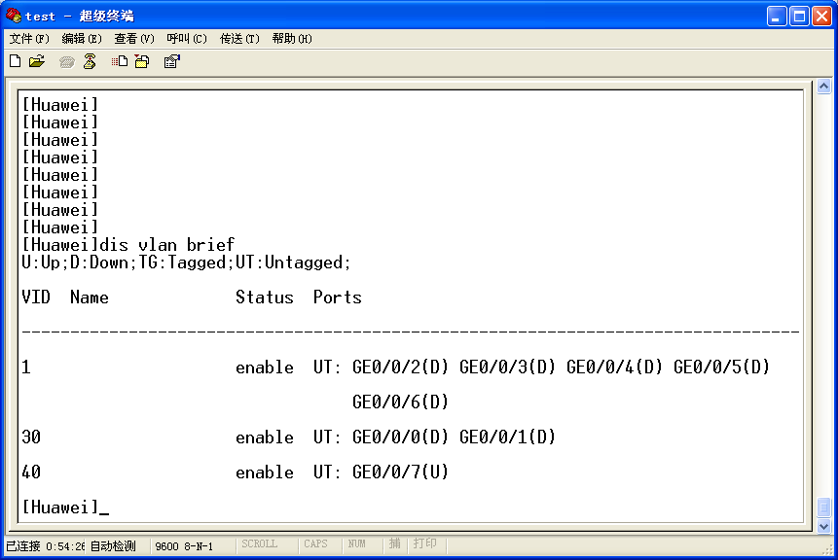
Project 3.3: Static route configuration(In AR1220E-S)
[Huawei]dis vlan brief

Slide 42
Project 3.3: Static route configuration(In AR1220E-S)
Step 10:Verify the communication in PC1,PC2,PC3, PC4 and PC8
ping 192.168.10.1,2,3,4…
ping 192.168.40.1…
DMZ
GE 1/0/1
192.168.50.1
Firewall(USG6300)
GE 1/0/5
202.100.100.1
GE 0/0/0
202.100.100.254
GE 1/0/0
192.168.30.1
PC7
GE 0/0/7
192.168.40.254/24
LAN A
GE
1/0/24
VLAN 30
192.168.30.254/24
Switch A
GE1/0/1~
GE1/0/4
GE1/0/5~
GE1/0/6
PC8
PC1 PC2 PC3 PC4
PC5 PC6
Internet
192.168.40.0/24
VLAN 10
192.168.10.0/24
VLAN 20
192.168.20.0/24

Slide 43
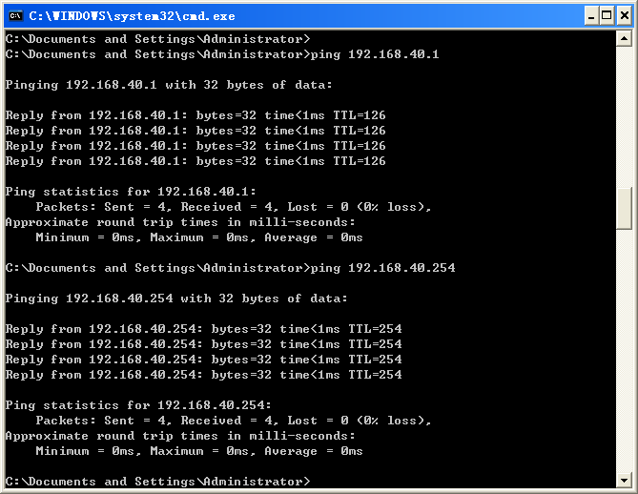
Project 3.3: Static Routing Configuration(In router)

Slide 44
Thank You !

